Slide 1
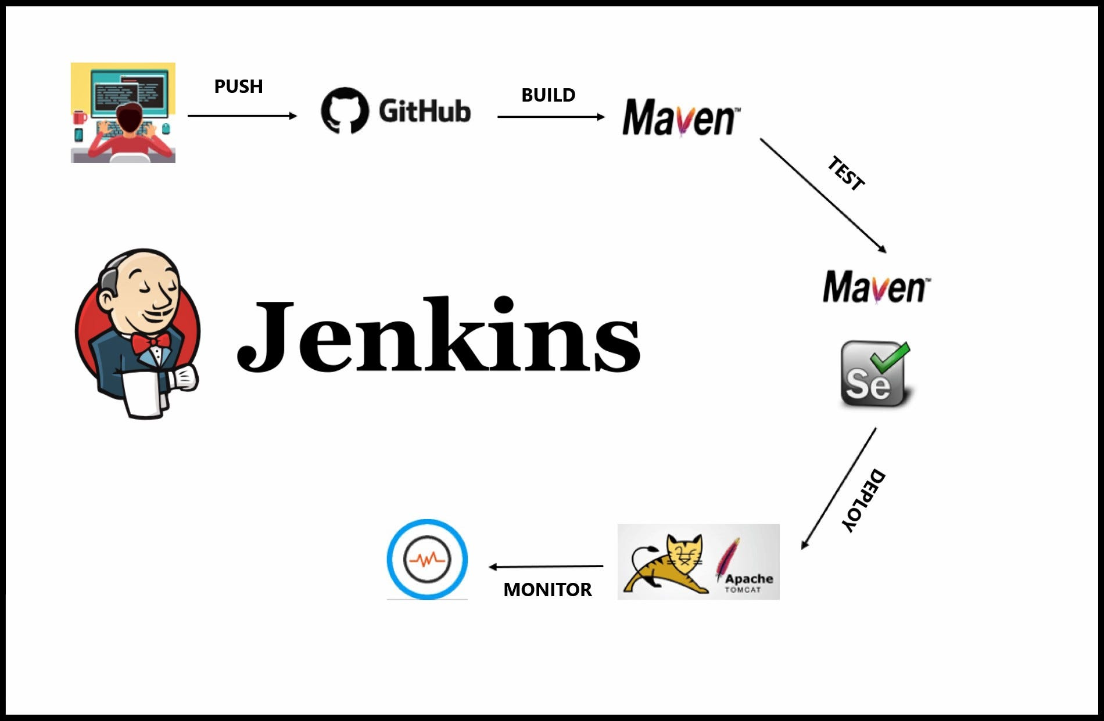
Jenkins

Slide 2
What is Jenkins
Jenkins is an open-source automation tool written in Java with plugins built for Continuous Integration purposes.
Jenkins is used to building and test your software projects continuously making it easier for developers to integrate changes to the project, and making it easier for users to obtain a fresh build.
It also allows you to continuously deliver your software by integrating with a large number of testing and deployment technologies.

Slide 3
What is Jenkins CI/CD Pipeline?
Jenkins CI/CD stands for Continuous Integration / Continuous Deployment
In computing, a pipeline is a set of stages or processes linked together to form a processing system. Each stage in the pipeline takes an input, processes it in accordance with a set of rules, and then sends the outputs to the stage that follows.
Test code
Build Application
Push Repository
Deploy to Server
All the steps mentioned above will perform in sequence one after the other if any step/stage get failed it will not move forward to another step/stage until the previous step got a success.

Slide 4
Benefits of Continuous Integration (CI)
Jenkins Continuous integration means whenever new code is committed to remote repositories like GitHub, GitLab, etc. Continuous Integration (CI) will continuously build, tested, and merged into a shared repository.
We can maintain the reports of the projects
Deployments can be made within the given time
Bugs can be found quickly.

Slide 5
What is Jenkins Continuous Deployment/Delivery (CD)?
Continuous Deployment
Continuous Deployment means automating the further stages of the pipeline automatically or manually deploying the application/code to different environments like Dev, Test, and Production. Automating the build is the main component of Continuous Integration and Continuous Deployment.
Continuous Delivery
Each and every build that passed all automated tests and was able to be fully automated and delivered into production only required one click of human intervention is called Continuous Delivery.

Slide 6
Jenkins Installation
1. Install JDK 11/17 as Jenkins support only these two versions.
2. Open Google, search Jenkins download. Download Jenkins LTS(long term service, stable one) for windows(MSI file).
3. Double click msi installer, “run service as local system”, click next.
4. Select port number(default : 8080) and next
5. Select jdk17 path and next
6. Install firewall on local hard drive, next, installation starts and finish wizard.

Slide 7
Jenkins Installation
7. Open any browser and type localhost:8080.
8. Unlock Jenkins with admin password. Open command prompt C drive and
type the below command:
notepad C:\ProgramData\Jenkins\.jenkins\secrets\initialAdminPassword
9. Notepad opens with password. Enter the password in localhost:8080.
10. Then you will be provided with two options: install suggested/selected
plugins
11. Install suggested plugins. Then page appears to create admin. You can create
admin and start working.

Slide 8
Server Installation
Servers run applications and provide services so that users can access them as if they are running on a remote machine.
When you deploy an application on a server, it handles all the processing, and clients (users) interact with it over a network. This makes it feel like the application is running on a remote system, even though you're accessing it from your local device.
For example:
A web server (like Apache or Nginx) serves web pages so that users can see them in a browser.
An application server (like Tomcat or WildFly) runs backend logic for web applications.
A database server (like MySQL or PostgreSQL) stores and retrieves data for applications.
Download and install apache tomcat with different port number. As default port is 8080 for tomcat, it is already used by Jenkins.

Slide 9
Lab Program 2
Continuous Integration with Jenkins:
Tool: Jenkins
Program:
Install and configure Jenkins.
Create a simple pipeline to:
Clone a Git repository.
Build a sample project (e.g., a Java Maven or Python project).
Run test cases and archive the results.

Slide 10
Build a sample project
Step-1: Create maven project with .war format
Step-2: Create one html/jsp file in “src/main/webapp/index.html” and add HTML code to it. You can also include css and javascript.
Step-3: Create “src/main/webapp/WEB-INF” folder. In that “src/main/webapp/WEB-INF/web.xml” file.
Step-4: Include below plugin in “web.xml”
<plugin>
<groupId>org.apache.maven.plugins</groupId>
<artifactId>maven-war-plugin</artifactId>
<configuration>
<webXml>src\main\webapp\WEB-INF\index.jsp</webXml> (mention which page to start)
</configuration>
</plugin>
Step-5: Update project – Maven clean install compile test (make sure build successful)

Slide 11
Adding Project to git
Open terminal/command prompt, navigate to project directory and run
“git init”
Step 1: Create a GitHub Account and create new repository
Step 2: Install Git on Your PC, Configure your name and email
Step 3: Initialize Git in Eclipse:
Open Eclipse and go to your Maven project in the Project Explorer.
Right-click the project → Team → Share Project.
Select Git, then click Next.
Click Create to create a new local Git repository.
Click Finish.
Step 4: Add & Commit Files
Right-click the project → Team → Add to Index (this stages all files for commit).
Right-click again → Team → Commit.
Enter a commit message like "Initial commit" and click Commit.

Slide 12
Adding Project to git
Step 5: Connect to GitHub and Push
Copy your GitHub repository URL (from the GitHub page where you created the repository).
In Eclipse:
Right-click the project → Team → Remote → Push.
Click Create Remote.
Enter origin as the remote name.
Paste the GitHub repository URL.
Click Next.
Select Branch to Push:
Source ref: master (or main, depending on GitHub).
Destination ref: master (or main).
Click Next, then Finish.
Enter your GitHub username & password (or personal access token if GitHub asks).
Step 6: Verify on GitHub
Go to your GitHub repository page and refresh. You should see your project files uploaded!
Note: Next time when you modify your project in eclipse follow step 4 and 5 with commit message as “updated version”.

Slide 13
Jenkins Configuration & Tomcat
1. Follow video to configure Jenkins job.
2. In tomcat, open “C:\Program Files\Apache Software Foundation\Tomcat 9.0\conf\tomcat-users.xml” in notepad and add below code before ending tag:
<role rolename="manager-gui"/>
<role rolename="admin-gui"/>
<user username="tomcat" password="tomcat" roles="manager-gui,admin-gui,manager-script,manager-jmx,manager-status"/>
Build Jenkins and run tomcat -> manager-app -> click on your application to see output.

